Slide 1




Slide 2
Agenda
Background / Problem Statement
Objective
Solution Overview
Implementation/ Architecture
Results / Evaluation
Future Work

Slide 3

Problem Statement / Objective / Solution Overview

Slide 4
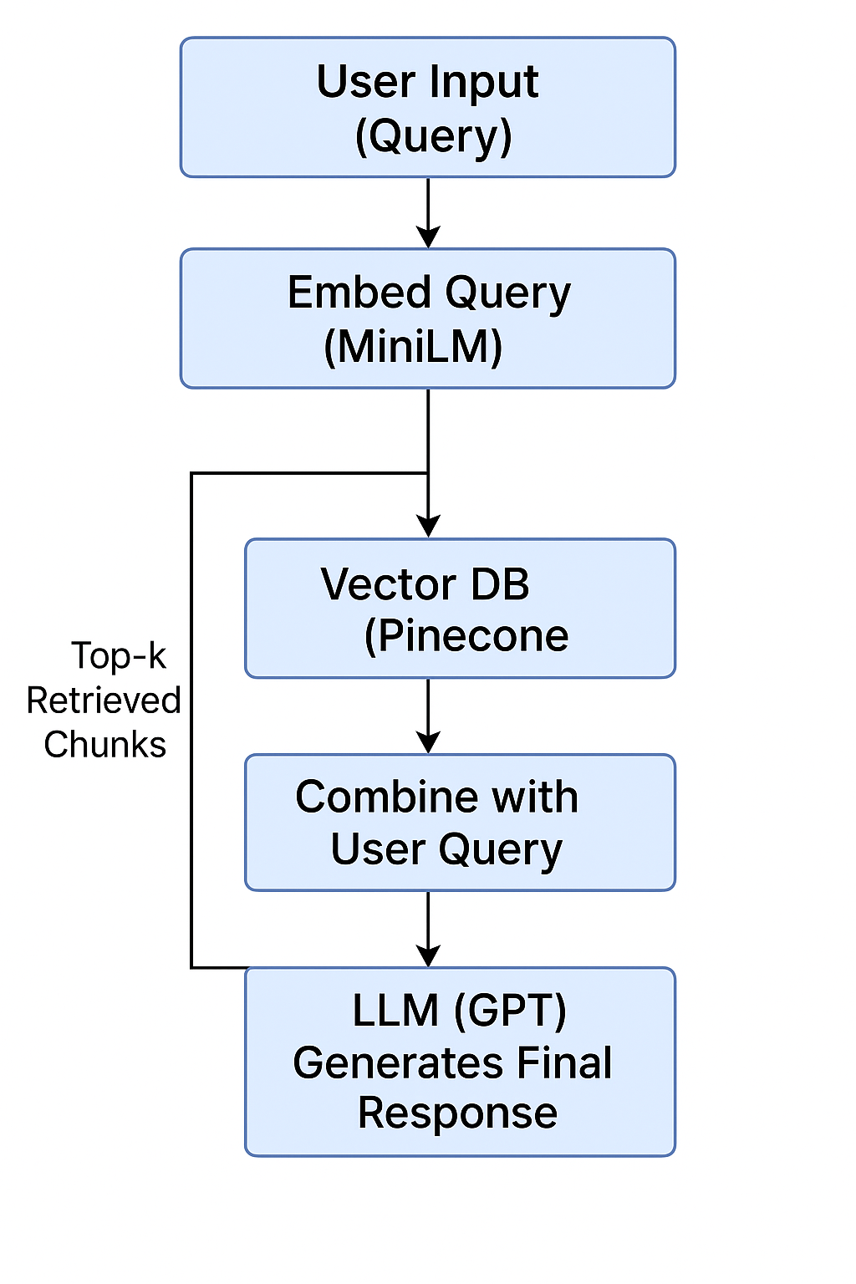
Implementation/ Architecture
Streamlit – front-end & user interaction
Whisper – audio transcription
HuggingFace Embeddings – vector embedding
Pinecone – vector store for retrieval
LangChain – building the retrieval-augmented QA chain
KeyBERT – keyword extraction
OpenAI GPT-3.5 – text generation (quiz, summary, etc.)
Agent- tools chooser
ReportLab / SMTP – PDF generation and email sending
Langsmith- mortaring performance

Slide 5
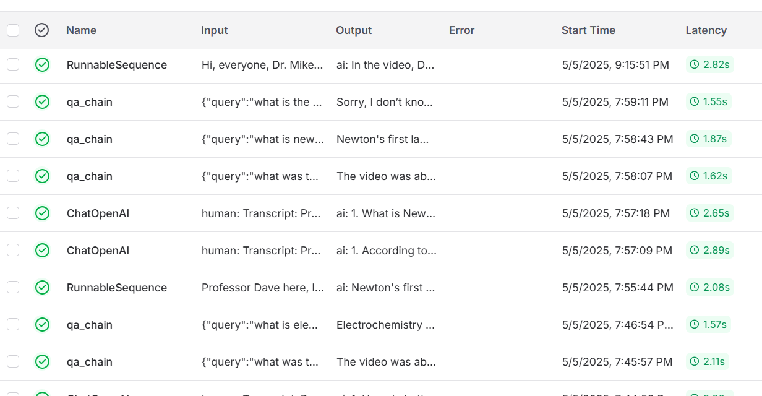
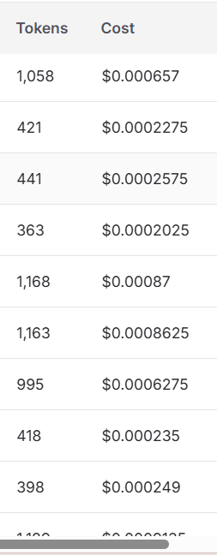
Results / Evaluation

Slide 6
Future Work
Teacher/Trainer Dashboard
Custom Voice Assistant Integration
User Progress Tracking
Adaptive Quiz Difficulty
Cloud Deployment

